Slide 1



Demystifying Git
Adam Matan, SW Team Leader, Wix Code
adamatan@wix.com twitter@adammatan linkedin/adamatan github.com/adamatan

Slide 2

> whoami
Adam Matan

Slide 3
Back in 2013 I started learning Git.

Slide 4
2013
Stick to add, commit, push, and pull

Slide 5
Something goes wrong
2013
Stick to add, commit, push, and pull

Slide 6
You are in 'detached HEAD' state.
You can look around, make experimental changes and commit them, and you can discard any commits you make in this state without impacting any branches by performing another checkout.

Slide 7
Something goes wrong
2013
Stick to add, commit, push, and pull
Found stackoverflow magic

Slide 8
Read the manual
Something goes wrong
2013
Stick to add, commit, push, and pull
Found stackoverflow magic

Slide 9
git-reset
Reset current HEAD to the specified state

Slide 10
git-reflog
Manage reflog information

Slide 11
Something goes wrong
Read the manual
2013
Stick to add, commit, push, and pull
Found stackoverflow magic
Trial and error

Slide 12
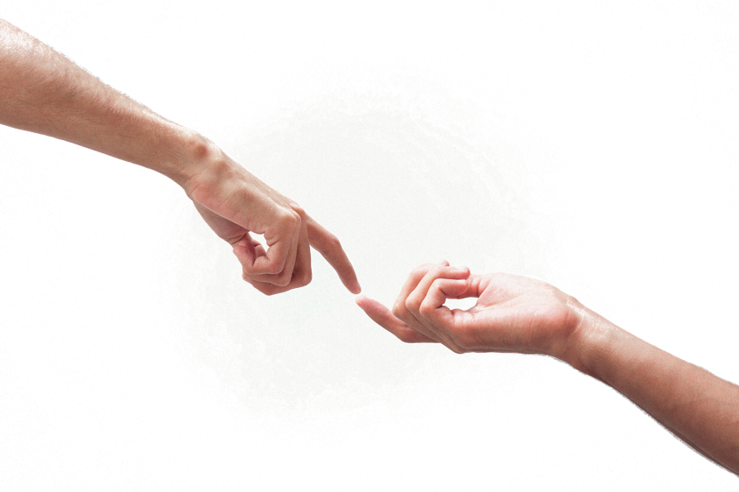
Power
language

Slide 13
Git is...
Trees
Objects
Pointers

Slide 14
Trees
file
dir
file
file
dir
file

Slide 15
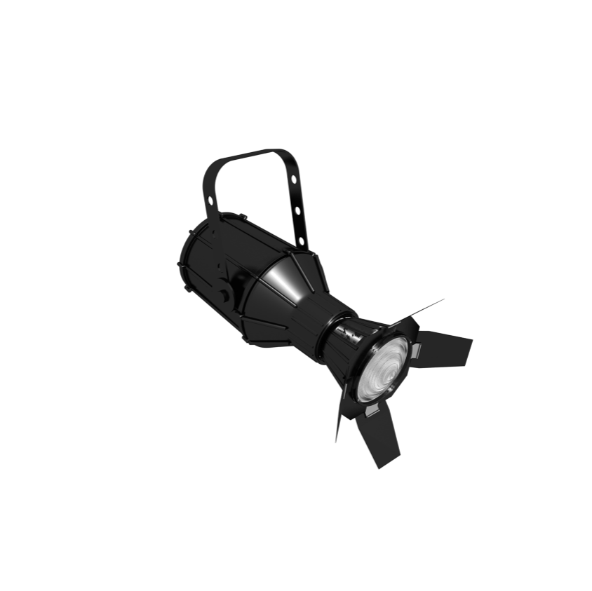
Trees
Staging area
Working dir
Commits

Slide 16
Trees
Staging area
add
Working dir
Commits

Slide 17
Trees
Staging area
add
commit
Working dir
Commits

Slide 18
Trees
Staging area
add
commit
Working dir
Commits
checkout
Notes:
Commits are full independent snaphots
“I always commit everything / IDE does it for me”

Slide 19
Objects
File (blob)
Tree
Commit

Slide 20
Objects
Are kept as compressed files.

Slide 21
Objects
File name is SHA-1 hash
.git/objects/833592c9df1b118af602de54 filename is SHA1-ha
.git/objects/5c60166876461ad757d80d3e
.git/objects/d5184ef704284477e24fc3c0
.git/objects/eab683a4a58ee4f9b2d917d0
.git/objects/cc7c6b3cd7b6512eb9724a49
.git/objects/e61ef7b965e17c62ca23b6ff
.git/objects/e898f7071923b09364a48f00

Slide 22
Objects
File name is SHA-1 hash
.git/objects/833592c9df1b118af602de54 filename is SHA1-ha
Notes:
All blobs from all commits are kept together flatly.
Duplications are impossible.

Slide 23
Objects
.git/objects/833592c
# git cat-file -p 833592c
See a file’s content

Slide 24
Objects
.git/objects/833592c
# git cat-file -p 833592c
#!/usr/bin/env python3
print("Hello!")
See a file’s content

Slide 25
Objects
.git/objects/cc7c6b3
# git cat-file -p cc7c6b3
See a tree’s content

Slide 26
Objects
.git/objects/cc7c6b3
# git cat-file -p cc7c6b3
100644 blob 833592c code.py
100644 blob 146de1c README.md
040000 tree ab89a4d config
See a tree’s content

Slide 27
Objects
.git/objects/e898f70
# git cat-file -p e898f70
See a commit’s content

Slide 28
Objects
.git/objects/e898f70
# git cat-file -p e898f70
tree cc7c6b3
parent d5184ef
author Adam Matan 1557778029
committer Adam Matan 1557778029
Awesome commit message

Slide 29
Objects
cc7c6b3
e898f70
833592c
833592c
Tree cc7c6b3
Parent
adf77ae
Awesome commit message
d5184ef

Slide 30
Objects
cc7c6b3
e898f70
833592c
833592c
Tree cc7c6b3
Parent
adf77ae
Awesome commit message
adf77ae
d5184ef
cc7c6b3
cc7c6b3
Notes:
Advantages:
Comparison is quick. Let’s say we have a huge repo. 10 files are changed. We only compare text files.
Commits are small (4k). Don’t be afraid to commit a lot.
Commits are independent, not diffs or changesets

Slide 31
Pointers
HEAD points to the current branch
Branch points to the current commit
HEAD
master
Notes:
Remembering hashes is hard. So, Git pointers, e.g. references, are a way of naming commits.

Slide 32
Pointers
The HEAD content
# cat .git/HEAD
ref: refs/heads/master
HEAD
master

Slide 33
Pointers
The HEAD content
# cat .git/HEAD
ref: refs/heads/master
# cat .git/refs/heads/master
e898f70
HEAD
master
The branch content
e898f70
master
Notes:
Branches are cheap

Slide 34
Pointers
latest commit
HEAD
master

Slide 35
Pointers
latest commit
HEAD
master

Slide 36
Pointers
latest commit
HEAD
master

Slide 37
Pointers
This is an attached HEAD.
HEAD
master

Slide 38

You are in 'detached HEAD' state.
You can look around, make experimental changes and commit them, and you can discard any commits you make in this state without impacting any branches by performing another checkout.

Slide 39
Pointers
This is a detached HEAD.
master
HEAD
111e0d0
git checkout 111e0d0
Notes:
Can commit, but we will not have a name for it and may lose it.

Slide 40
Pointers
Accidental commit to master
HEAD
master

Slide 41
Pointers
Accidental commit to master
HEAD
master

Slide 42
Pointers
Accidental commit to master
feature
HEAD
master
git branch feature

Slide 43
git-reset
Reset current HEAD to the specified state

Slide 44
Pointers
Accidental commit to master
feature
HEAD
master
git reset --hard HEAD~1

Slide 45
Pointers
Lost commit
HEAD
master

Slide 46
git-reflog
Manage reflog information

Slide 47
Pointers
Pointers
Git - reflog
19d10e7 HEAD@{0}: commit: ...
111e0d0 HEAD@{1}: commit: moving…
6a40b7b HEAD@{2}: clone: from...

Slide 48
Pointers
Lost commit
feature
111e0d0
HEAD
master
git branch feature 111e0d0

Slide 49
Pointers
Now let’s explain merge & rebase.
HEAD
master
0

Slide 50
Pointers
git checkout -b feature
master
0
feature
HEAD

Slide 51
Pointers
git commit -m message
master
1
0
feature
HEAD

Slide 52
Pointers
git commit -m message
master
2
1
0
feature
HEAD

Slide 53
Pointers
git commit -m message
master
2
1
a
feature
HEAD
0

Slide 54
Pointers
git commit -m message
master
2
b
feature
HEAD
1
a
0

Slide 55
Pointers
Let’s merge.
c
feature
HEAD
master
2
b
1
a
0
Notes:
Pros: True, Cons: hard to look in history

Slide 56
master
m
feature
HEAD
c
2
b
1
a
0

Slide 57
Pointers
Let’s rebase.
c
feature
HEAD
master
2
b
1
a
0

Slide 58
Pointers
c
feature
HEAD
master
2
b
1
a
0

Slide 59
master
c
feature
HEAD
b
a
2
1
0

Slide 60
master
c
feature
HEAD
b
a
2
1
0

Slide 61
So this is rebase.
c
c
b
2
b
a
1
a
2
1
0
0

Slide 62
What if ...
c
c
b
2
b
WIP
a
1
a
2
WIP
1
0
0

Slide 63
c
2
b
WIP
2
1
a
WIP
1
c
0
0

Slide 64
This is interactive rebase.
c
c
2
b
WIP
2
2
1
a
WIP
1
c
1
0
0
0

Slide 65
Git is Trees, Objects and Pointers.
If you get that, you’ll get git manuals, error messages, and repo states - without losing your HEAD.

Slide 66

Your next step - Katas!
github.com/adamatan/git

Slide 67



Credits & Thanks
Jessica Kerr (@jessitron), Git happens
David Thomas, GitLab, Fear Not The SHA!
Sessions
Lee Baror - for her wonderful work on the slide deck
Dror Kronstein - for his great advice
Assaf Lavie - for teaching me useful best practices
Issahar Weiss, Avraham Rosenzweig - For moderating me
Guy Kobrinsky - for useful feedback on my workshop at Outbrain
People

Slide 68

Thank You
adamatan@wix.com twitter@adammatan linkedin/adamatan github.com/adamatan

Slide 69

Q&A
adamatan@wix.com twitter@adammatan linkedin/adamatan github.com/adamatan

Slide 70
References
https://insights.stackoverflow.com/survey/2017#most-popular-technologies
https://insights.stackoverflow.com/survey/2019#development-environments-and-tools
https://insights.stackoverflow.com/survey/2018
Fake git command generator

Slide 71
Image credits
https://www.pexels.com/photo/fingers-touching-2172156/
Capitoline Museums [CC BY-SA 3.0] (https://creativecommons.org/licenses/by-sa/3.0)

